Slide 1
Cricket world cup 2023 analysis
BY: VINAYAK GUPTA
BATCH: MIP-ML-08

Slide 2
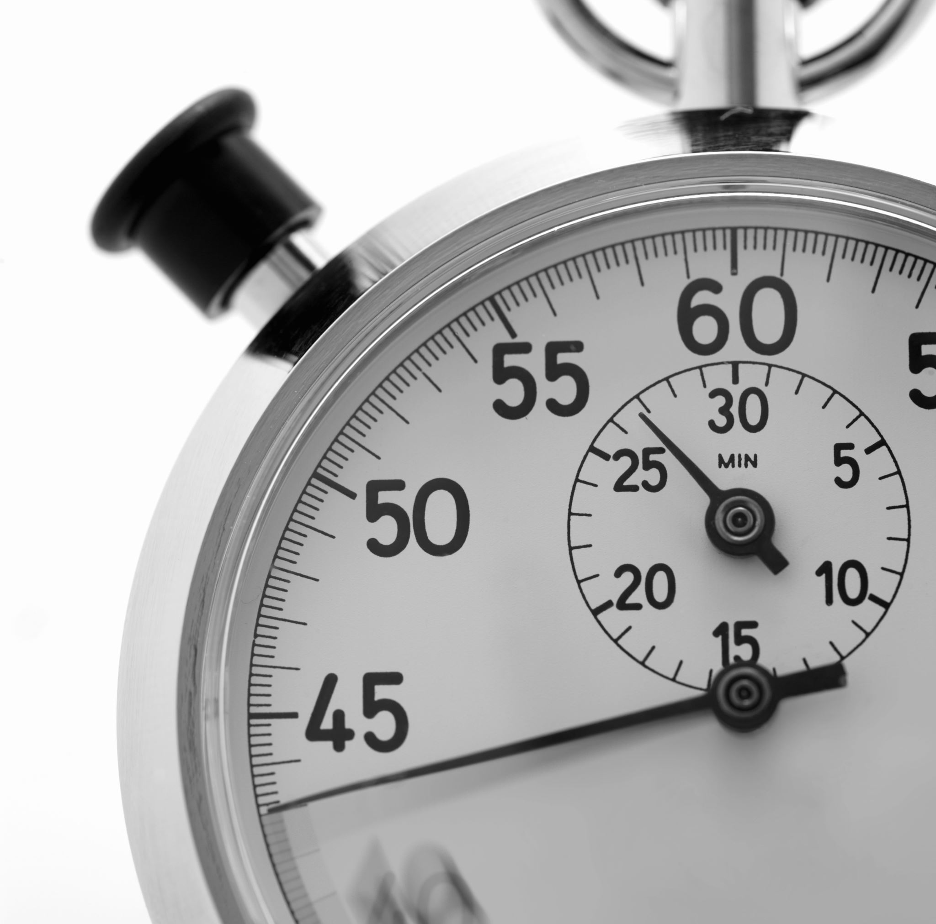
AGENDA
Project Overview
Dataset Overview
EDA
Data Preprocessing
Solution to given tasks

Slide 3

PROJECT OVERVIEW
The Cricket World Cup 2023 data analysis aims to delve into the cricketing world, specifically focusing on the performance of teams and players during the prestigious tournament. The dataset provided encapsulats a comprehensive array of features, offering an opportunity for us to conduct a thorough exploratory data analysis and extract valuable insights.

Slide 4
Dataset overview
The dataset comprises of the following columns:
team
player
bat_or_bowl
bb_bf (balls bowled or balls faced)
runs
wkts (wickets)
wicketball_prob
runs_per_ball
opposition
ground

Slide 5
Dataset overview
The dataset comprises of the following columns:
start_date
overs
mdns (maidens)
econ (economy rate)
inns (innings)
4s (fours)
6s (sixes)
sr (strike rate)l
not out
mins (minutes)

Slide 6
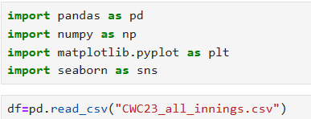
Importing essential libraries
Essential libraries are imported
Dataset is read from the stored location.
6

Slide 7
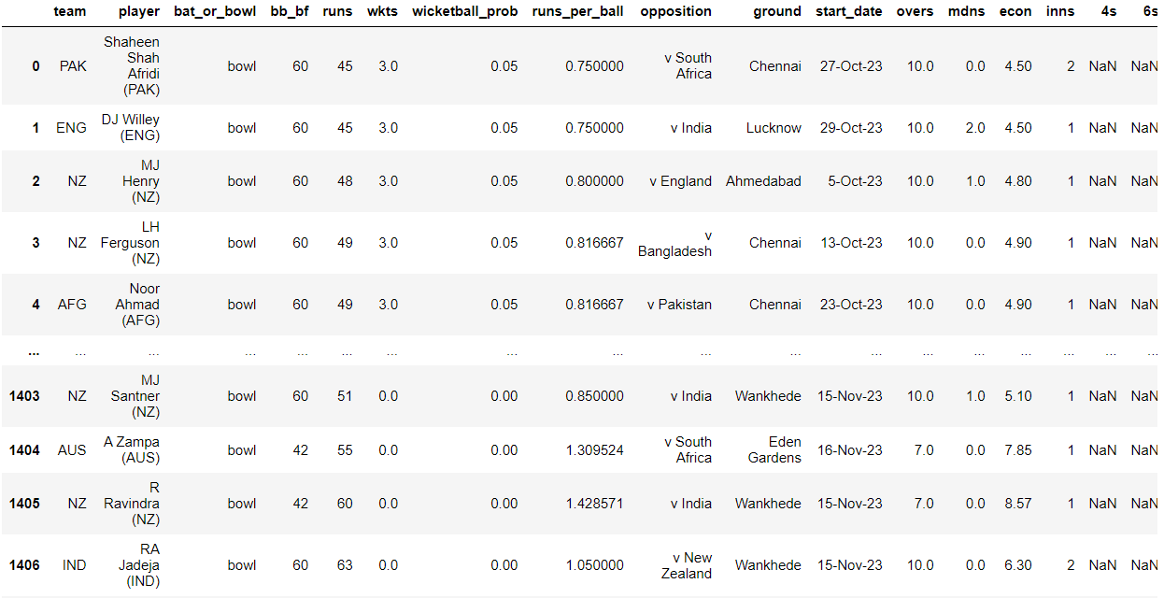
Provided dataset
The dataset provided has 1408 rows and 20 attributes.
Few of the Attributes are:
team
player
4s
wkts

Slide 8
EDA
In EDA, we'll observe the information and statististics.

Slide 9
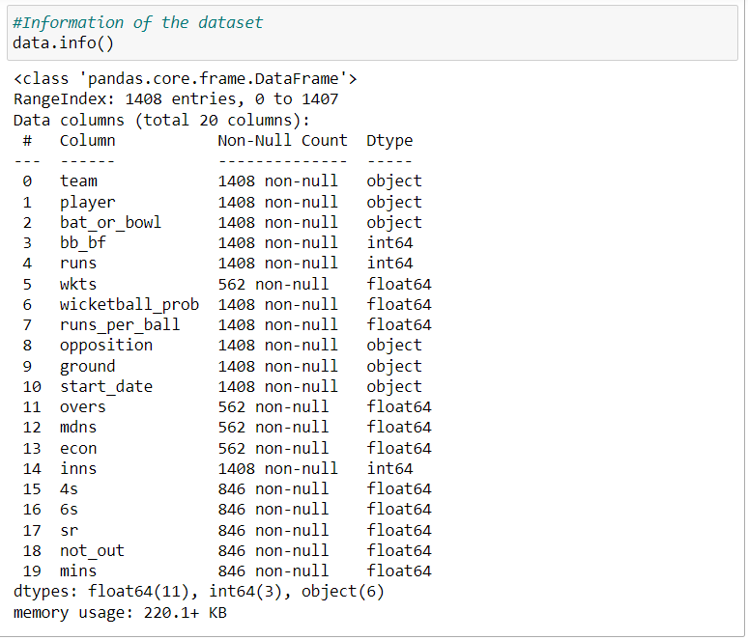
Dataset information
We can observe the information of the dataset like RangeIndex, Number of columns, data types, non-null count and the number of records of each attribute.

Slide 10
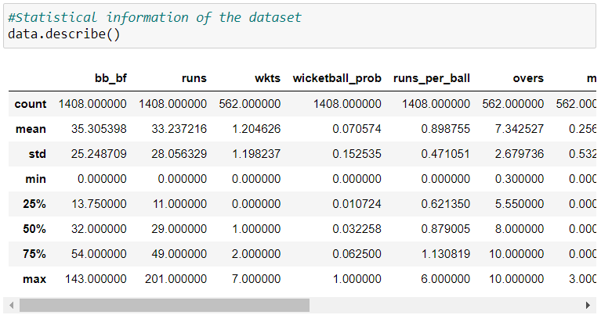
Dataset description
We can observe the statistical measures like mean, standard deviation, maximum and minimum values along with various quartile ranges for our dataset.

Slide 11
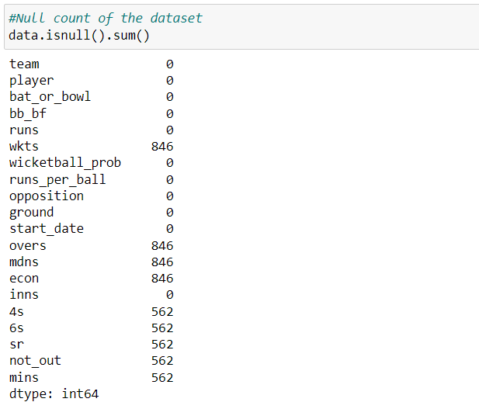
Null count of each attributes
Here we see the null count of:
'wkts': 846
'overs': 846
'mdns': 846
'econ': 846
'4s': 562
'6s': 562
'sr': 562
'not_out': 562
'mins': 562
All other attributes have zero null values

Slide 12
Data preprocessing
We'll transform the raw data into an understandable form for suitable analysis.

Slide 13
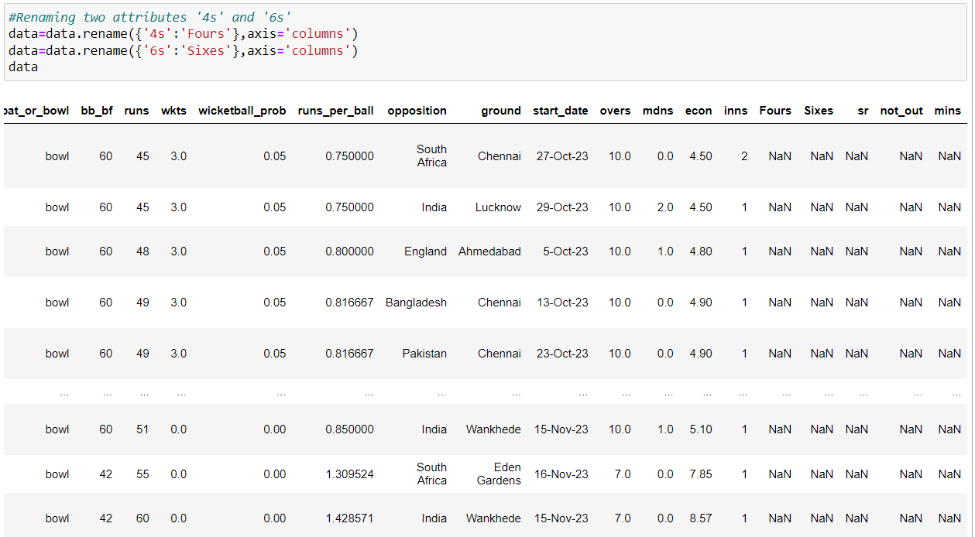
Data cleaning
Renaming the two attributes '4s' and '6s' with 'Fours' and 'Sixes' respectively.

Slide 14
Team performance analysis
This is our first task to perform, where we'll explore team-wise performance metrices, analyze runs scored, wickets taken and identify the top-performing teams.

Slide 15
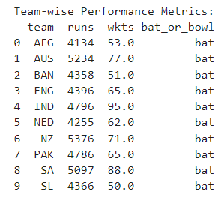
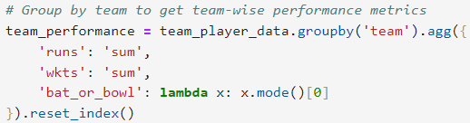
Explore team-wise performance metrics

Slide 16
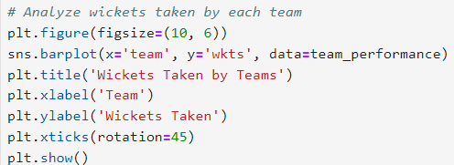
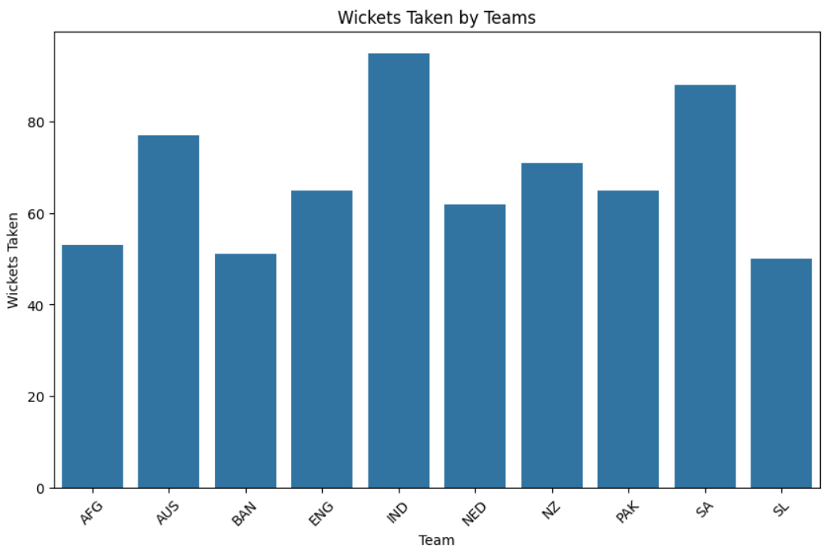
Team which took highest wickets
Using the barplot, we observe that the highest wicket-taking team is India with 94 wickets.

Slide 17
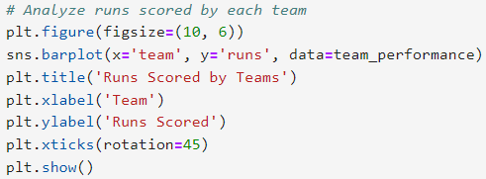
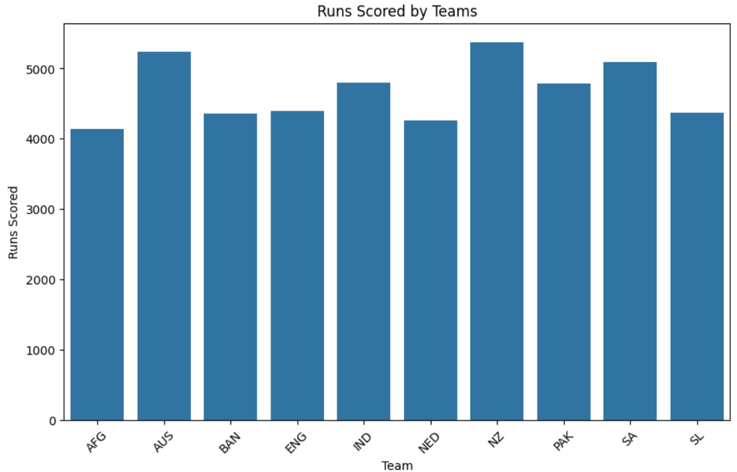
Team with highest Runs
Using the barplot, we observe that the team with highest runs is New Zealand(NZ) with 5376 runs.

Slide 18
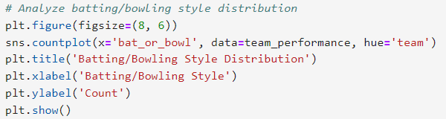
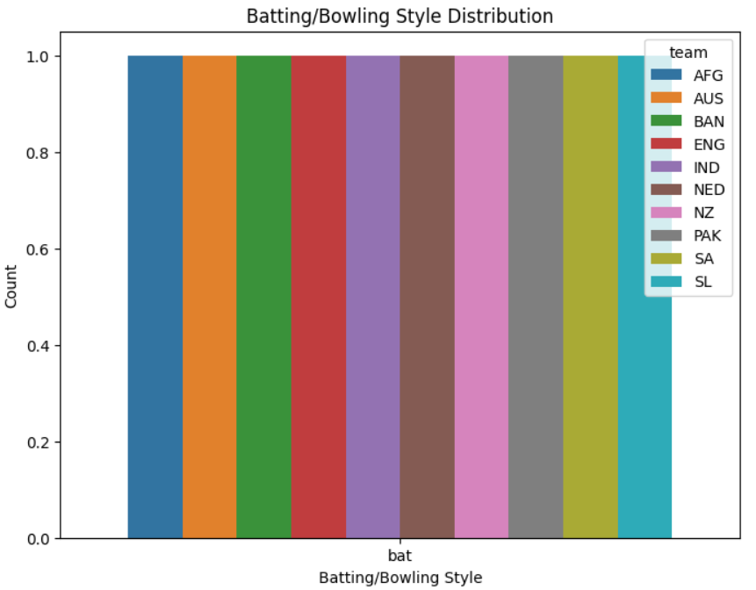
Teams with batting/bowling styles
Using the countplot, we observe that the top-team performing teams has more batting style.

Slide 19
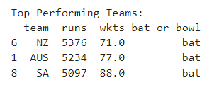

Team with top performance
We can observe that the team with top performance is team New Zealand in runs and South Africa in Wickets.

Slide 20
Player performance analysis
This is our second task to perform, where we'll explore player-wise statistics for both bowling & batting, identify leading run-scorers and wicket-takers, along with their impact on team's performance .

Slide 21
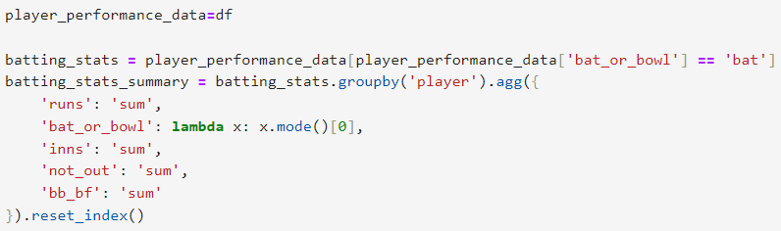
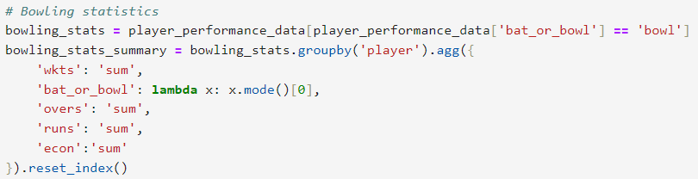
For Player wise statistics for both batting & bowling
We're using groupby function to group out According to Players

Slide 22
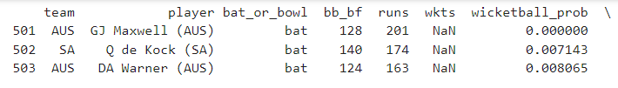
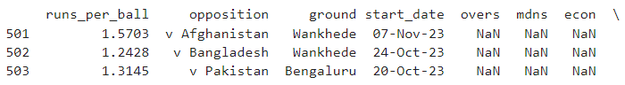
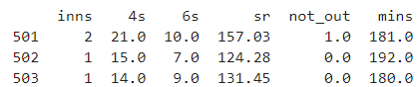
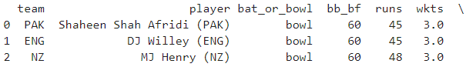
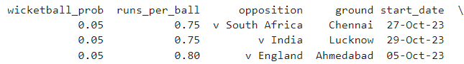
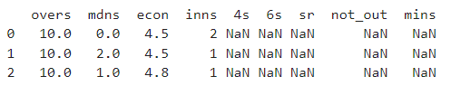
FOR BATTING
FOR BOWING

Slide 23
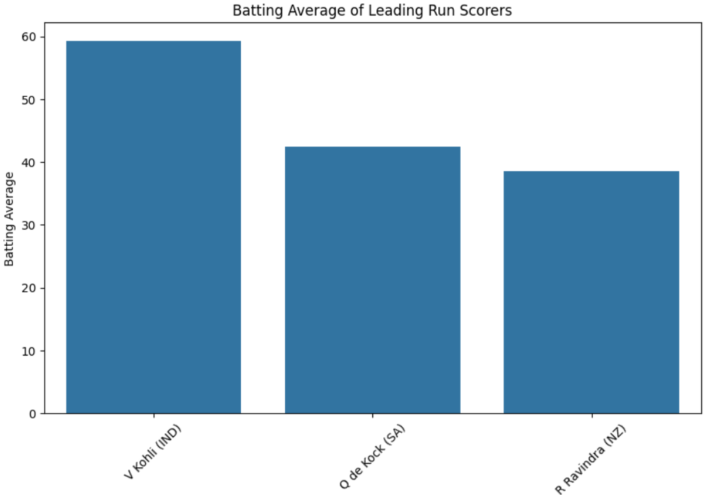
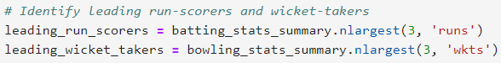
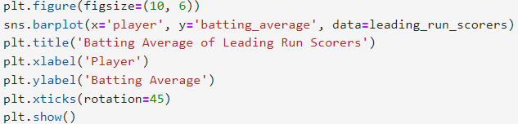
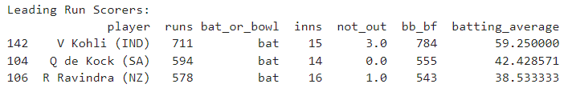
Identify leading run-scorers

Slide 24
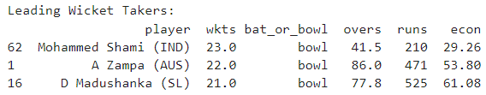
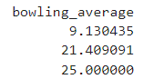
leading wicket-takers

Slide 25
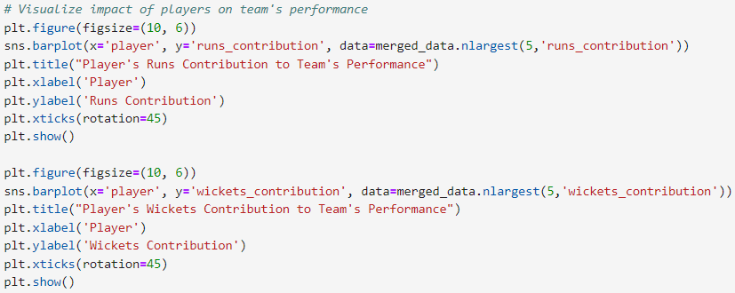
Assess the impact of players on their team's performance

Slide 26
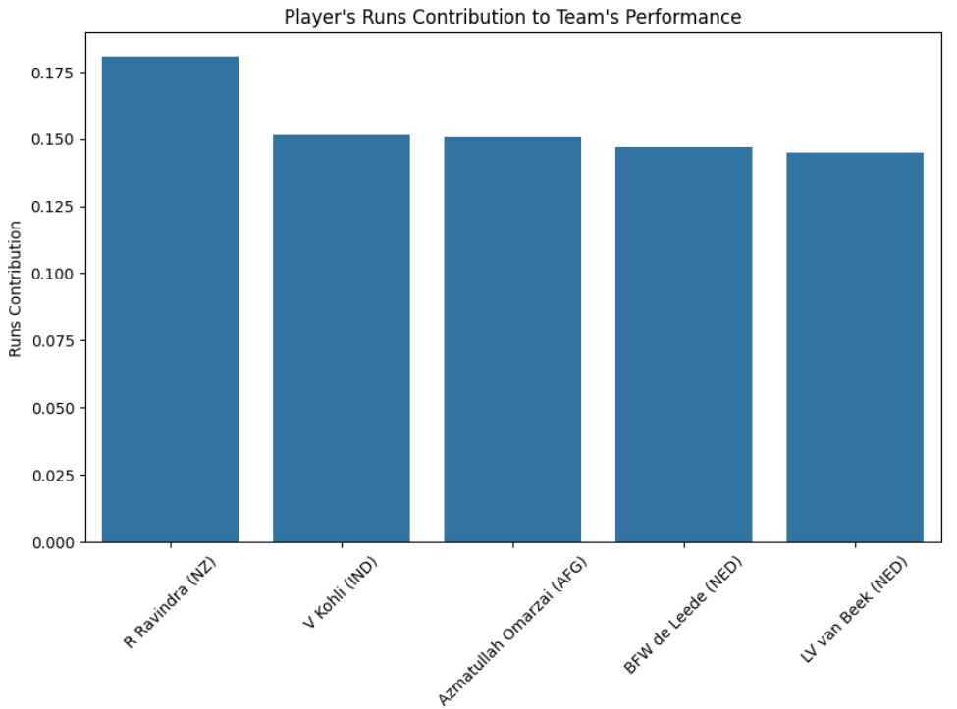
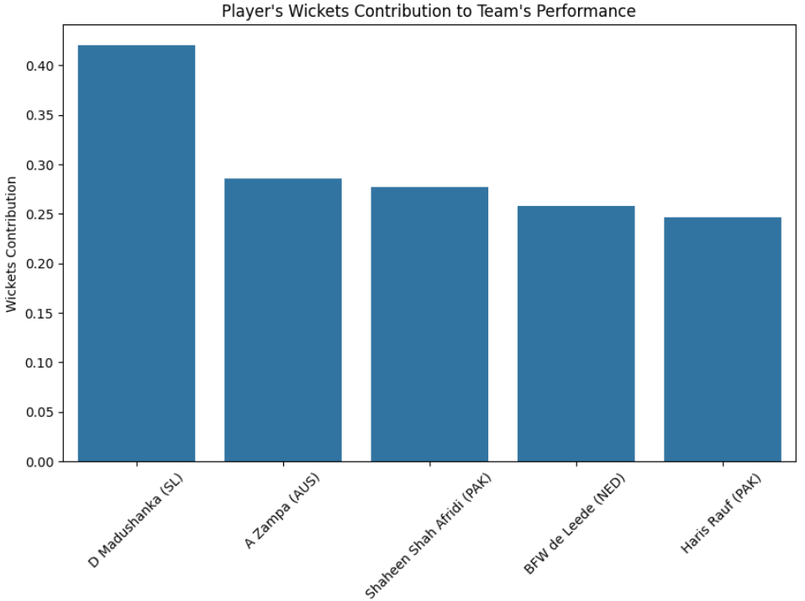

Slide 27
Opposition and ground analysis
This is our third task to perform, where we'll explore how teams perform against opposition, examine their performance variation amongst various grounds, and identify the strength of the team on certain conditions .

Slide 28
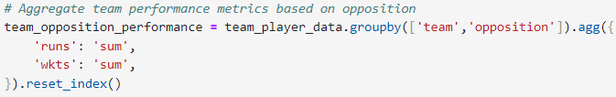
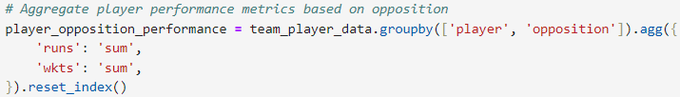
Investigate how teams and players perform against different oppositions

Slide 29
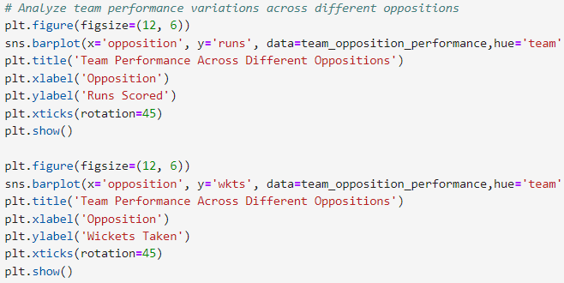
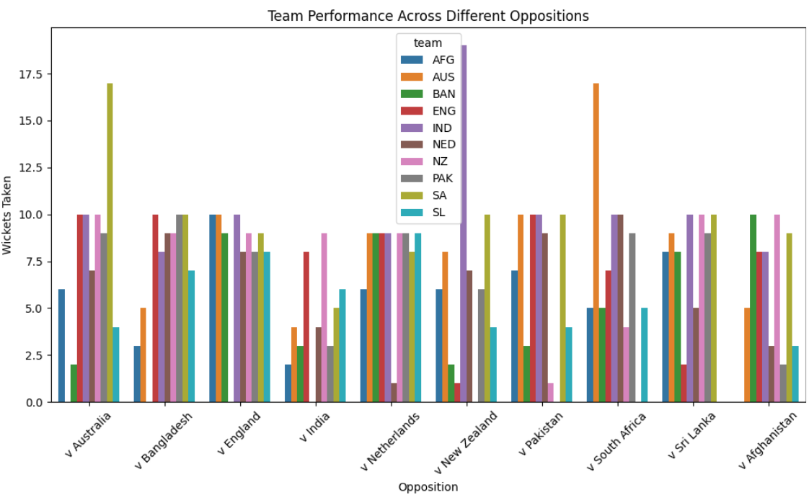
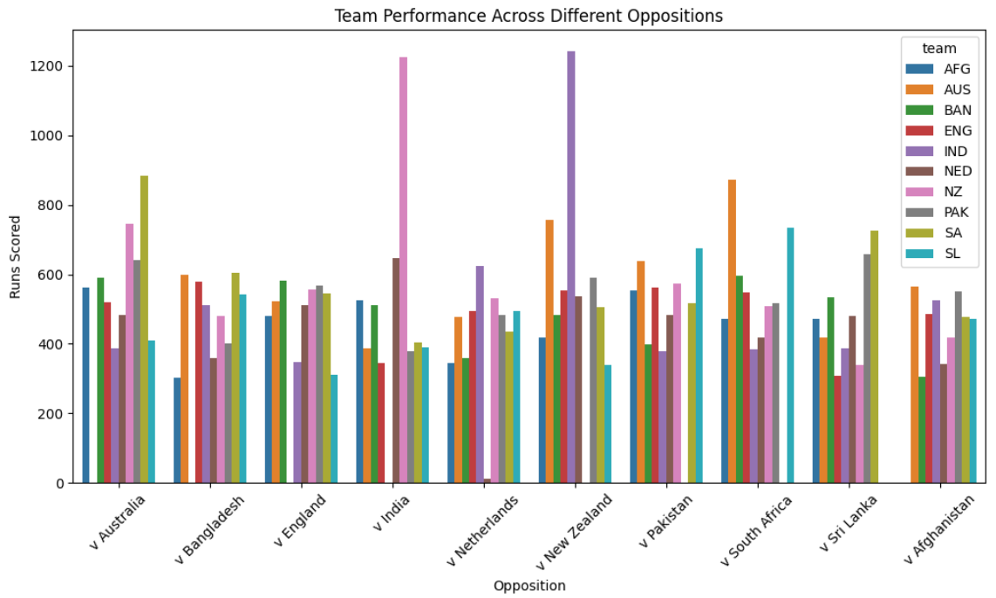

Slide 30
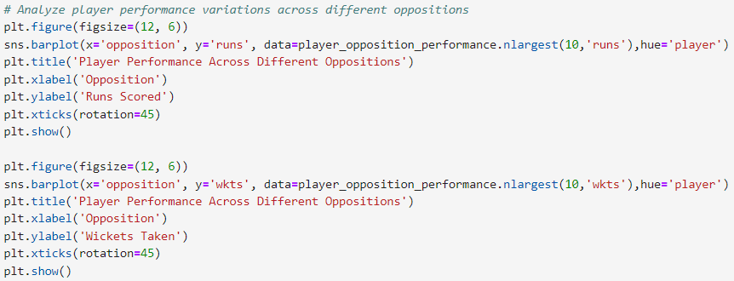
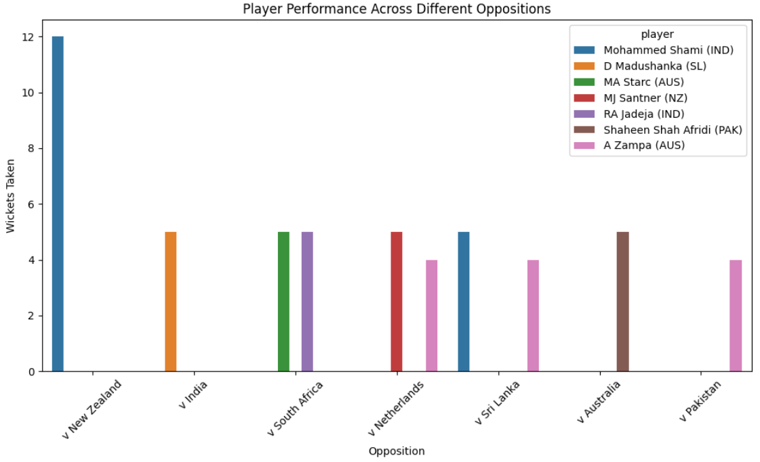
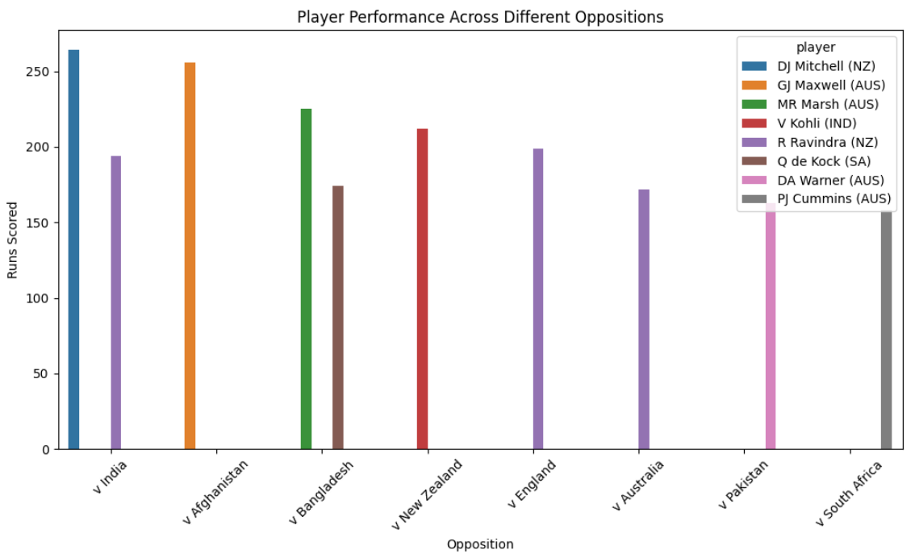

Slide 31
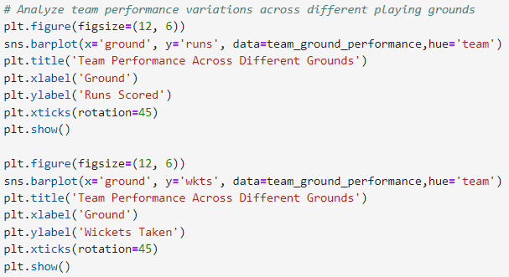
Examine performance variations across different playing grounds

Slide 32
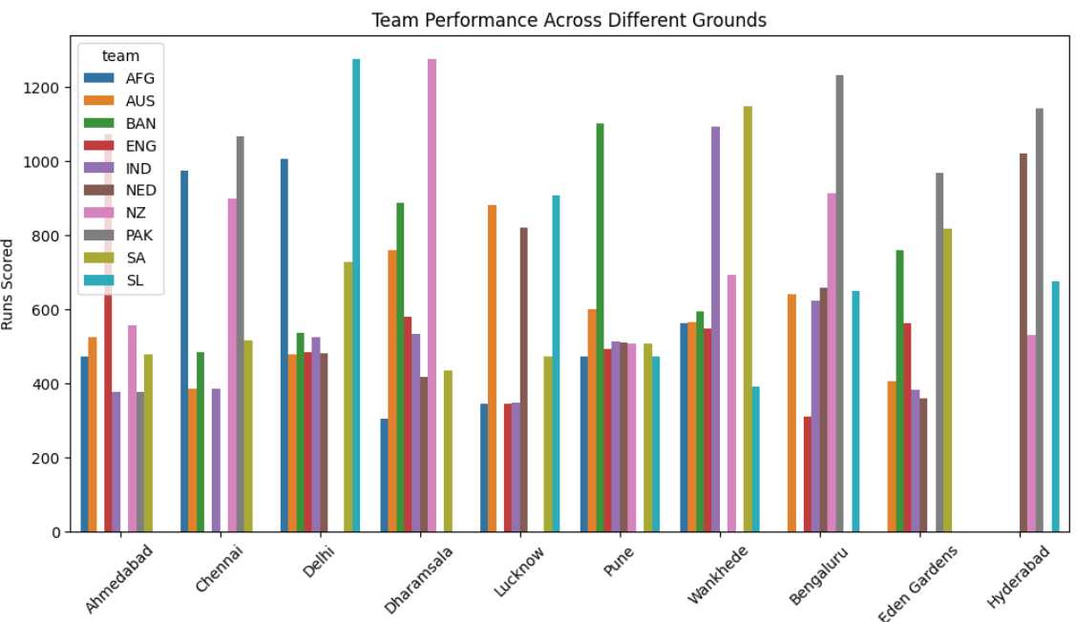
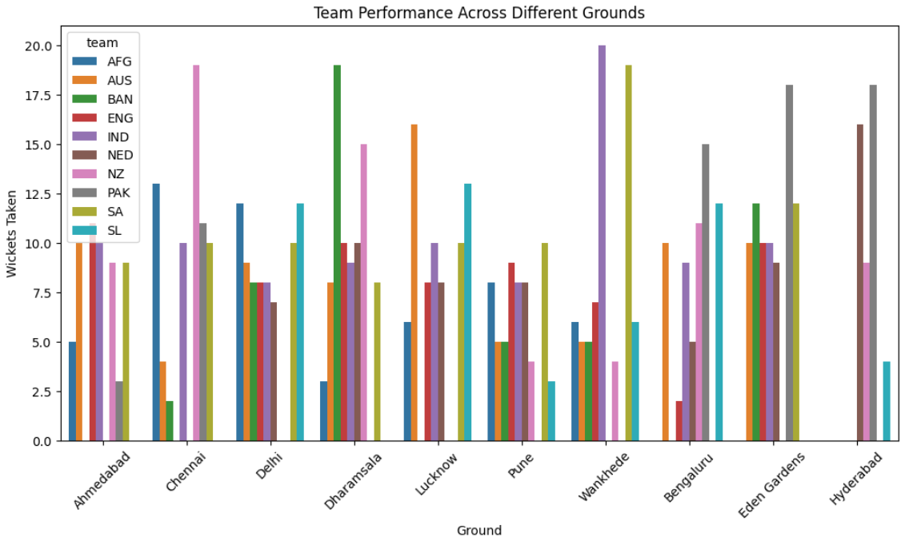

Slide 33
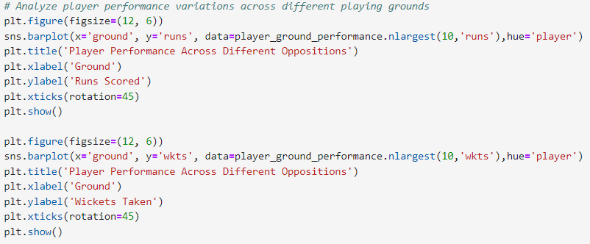
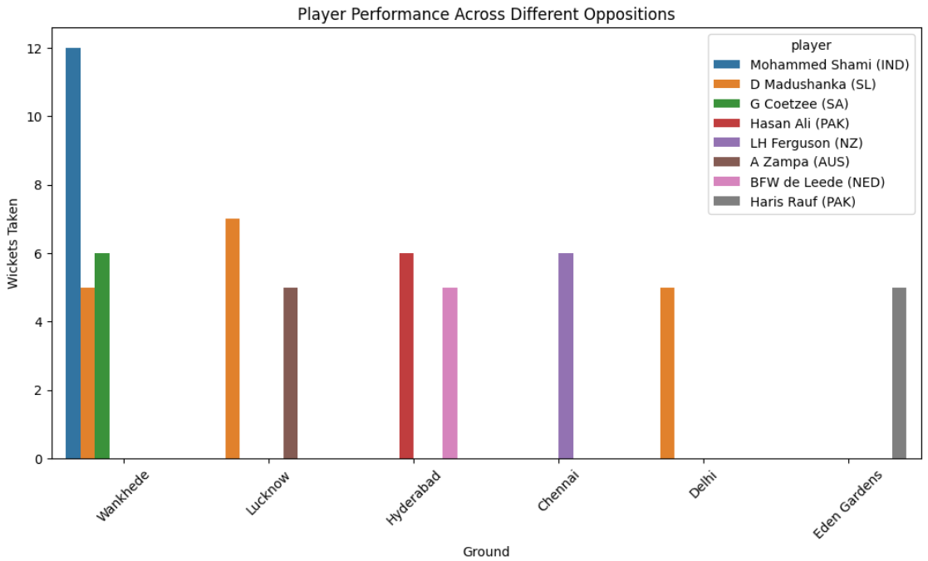
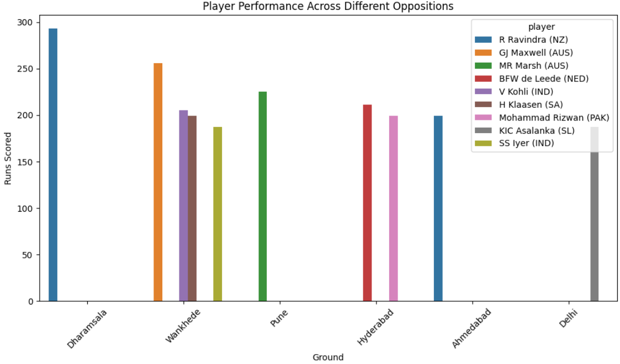

Slide 34
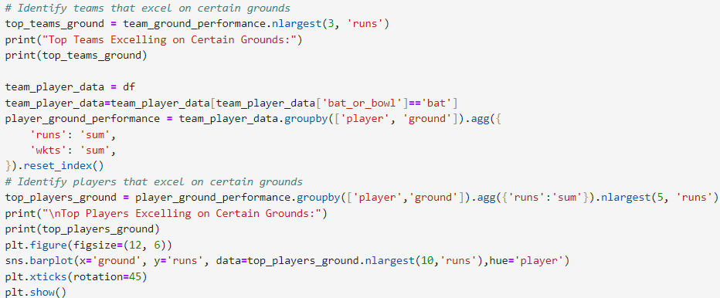
Identify if there are specific teams or players that excel in certain conditions

Slide 35
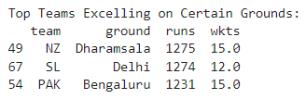
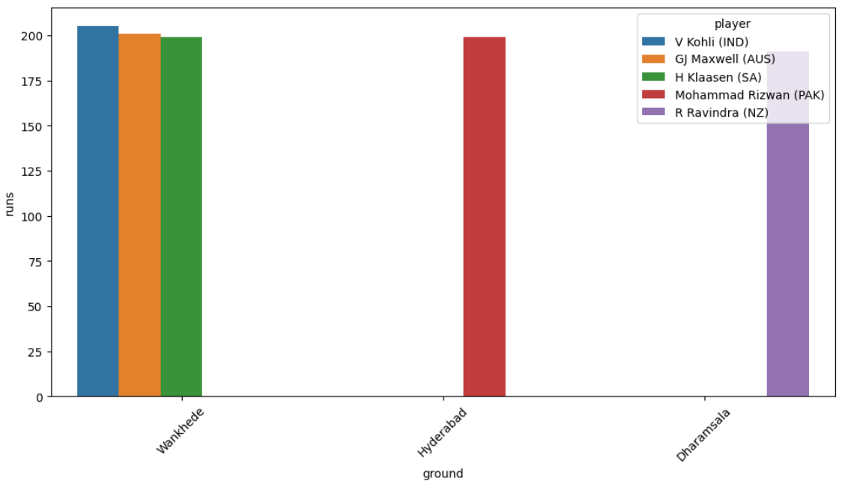
Identify if there are specific teams or players that excel in certain conditions

Slide 36
Temporal analysis
This is our final task to perform, where we'll explore performance trend over time, considering start date and overs played and at last identify any temporal changes in team.

Slide 37

Parsing the dataset
We've to parse the 'start_date' attribute such that its type changes from object to datetime.

Slide 38

Temporal analysis of all team
Using the lineplot, we observe that various teams like SA, AUS, IND has high temporal changes.

Slide 39


Temporal analysis of all team
Using the lineplot, we observe that various teams like SA, AUS, IND has high temporal changes.

Slide 40

Temporal analysis of team on the basis of runs-scored
Using the lineplot, we observe that teams during final overs are scoring good amount of runs.

Slide 41

Temporal analysis of team on the basis of wickets
Using the lineplot, we observe that teams during final overs taking wickets linearly.

Slide 42


Temporal analysis of player on the basis of Runs and wickets

Slide 43

THANK YOU
VINAYAK GUPTA
viniatul18@gmail.com
MIP-ML-08

